Slide 1

6MMCS001W Mobile User Experience Lecture
Mobile design principles – Images and Graphics

Slide 2
Recap from week 3
Layout and composition
Visual balance
Directing user to content
Gestalt principles
Emphasis
Emotional design
Typography
Colour

Slide 3
Images and graphics

Slide 4
Quality
Use good quality of images and graphics to achieve a professional feel

Slide 5

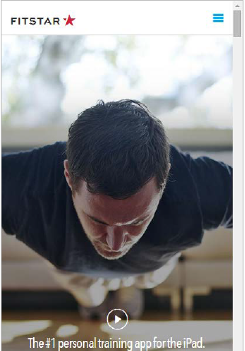
Cropping
1 image 1000 words but cropped images should be meaningful

Slide 6
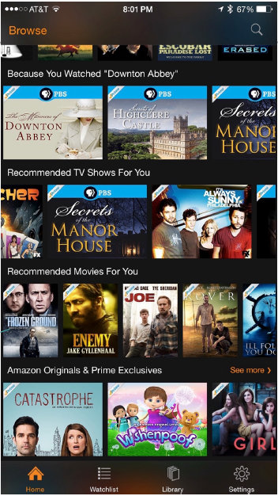
Legibility – beware shrinking images
Detailed images are difficult to read at smaller sizes
Better design option:
crop the photo
enlarge the thumbnails
Fonts within image are
too small to easily read

Slide 7
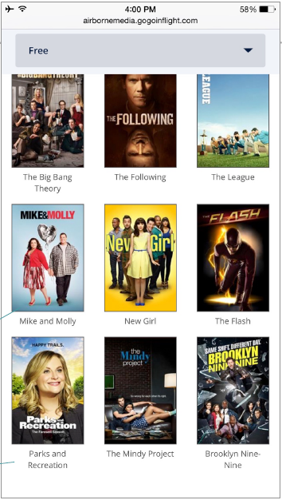
Legibility – beware shrinking images
Text labels are always clearer — make room to display them
Fewer items
displayed
allows for larger
images
Text label

Slide 8
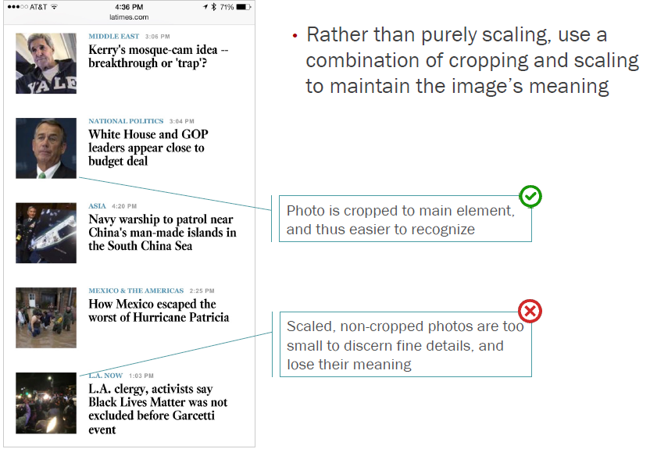
Relevance-enhanced image reduction

Slide 9
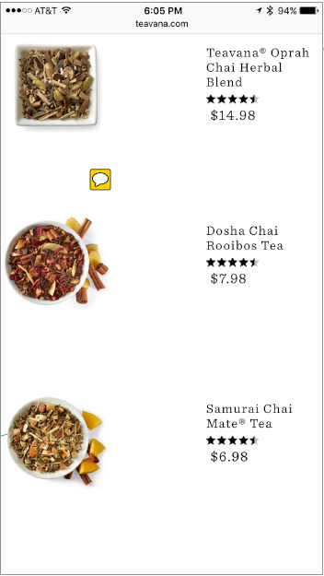
Avoid filler images
Does it help you to take a decision?
Before adding thumbnails, consider whether or not the image is needed to help users make a choice
When photos do not support the decision-making process, they will get ignored in favour of the information carrying text
Thumbnails of tea are not
meaningful, do not help
differentiate products

Slide 10
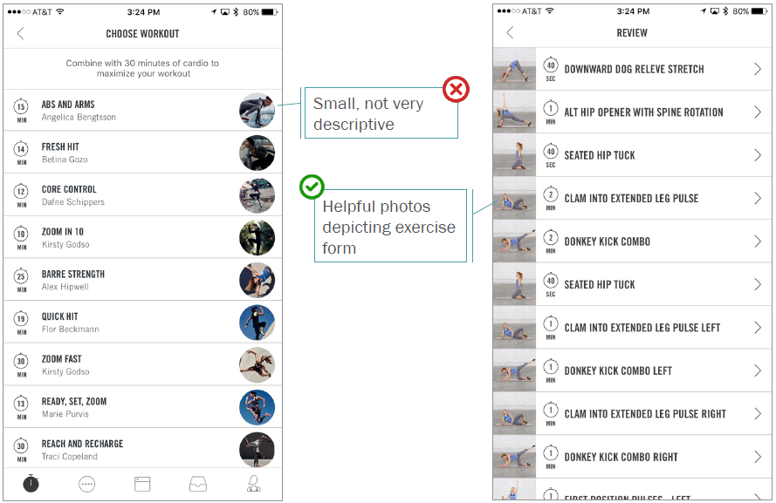
Avoid filler images

Slide 11
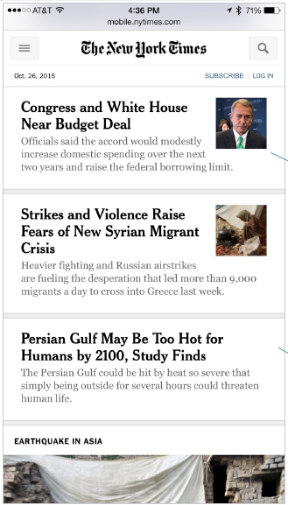
Right-aligned is the most flexible layout
Images can be omitted without shifting layout or leaving gaps

Slide 12
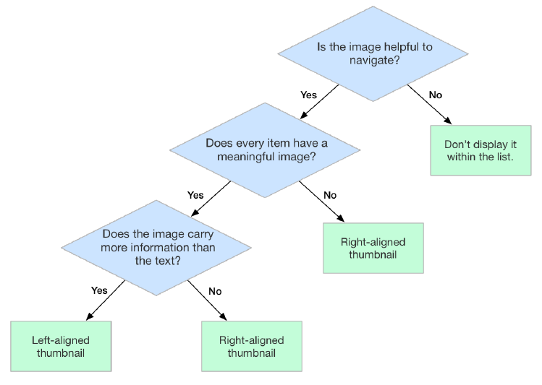
List thumbnails: right vs left placement

Slide 13
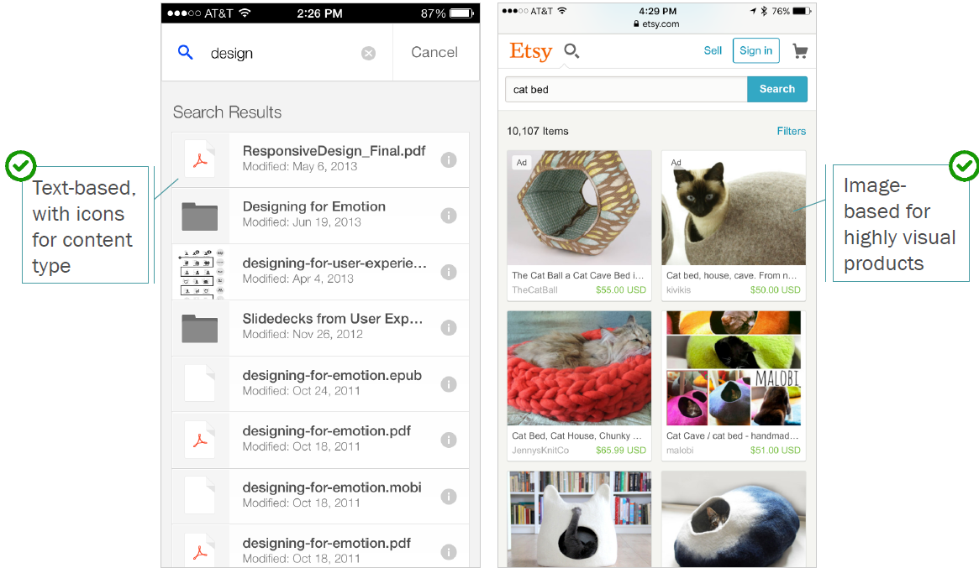
Icons or images?
Choose page layout and graphic display to match the type of content

Slide 14
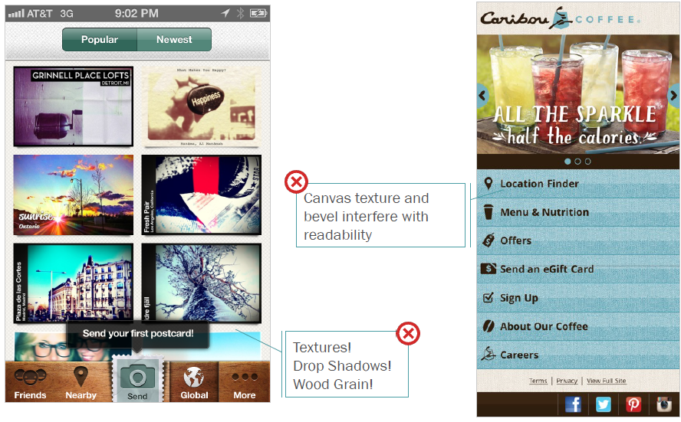
Don’t go overboard

